Slide 1
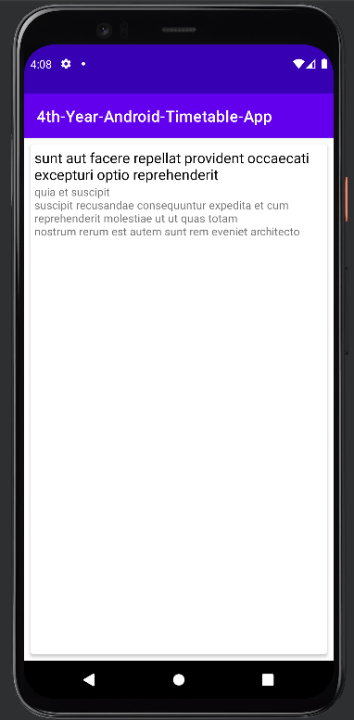
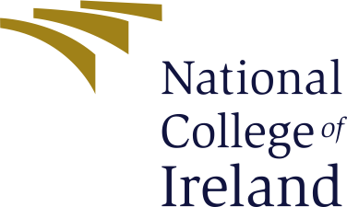
Alexis Roi Pechon Bachelor of Science (Honours) in Computing
Mobile Timetable Application
Abstract:
On a basic level, the main goal of my mobile project was to develop an Android Application that enables the user to access the timetables for different types of public transportation, whether it is by train or bus, my application aims to make finding timetables a streamline process that could all be done in the palm of your hands.
The purpose of this project was to create a mobile application that streamlines the process of the user looking up the next available bus or train by having all the information about their mode of transportation in one compact and useful mobile application.
Project Explanation
Technologies used
The following technologies were implemented in the development of the mobile application:
Java, APIs, JSON, XML, Retrofit

